Slide 1
An investigation on the knowledge disconnect between Qlikview BI developers and users
Particular focus on user incompetence
By Nicholas Wessels

Slide 2

What is meant by the Knowledge disconnect
the user’s incompetence to use the tool efficiently and effectively
developers lacking the business knowledge that the users have, and develop apps to provide the users exactly what they desire with minimum discomfort from both parties
This stunts successful BI in many organisations and creates a lot of unnecessary animosity between the 2 parties

Slide 3

Research Problem
With the rapid expansion of Big Data and people becoming aware of its importance and the wisdom it can hold.
BI is an exponentially growing industry, yet we are struggling to use these BI tools such as QlikView to their full advantage because of the divide in knowledge that the developers and users possess.
This project will focus on the users and their lack of expertise in using Qlikview.

Slide 4

Reviewed Literature
Friction between users and developers due to BI’s importance
W Pinnington et al. (2007) “if we consider business intelligence, enterprise systems, ‘users’ and ‘developers’, we begin to see potential tensions particularly as related to the potentialities for managing the fixed/fluid nature of business intelligence requirements and the relationship of this to so called user and developer roles.”
RJ Podeschi (2014) “it’s hard to find a good mix of technical and business skills, too often a person is skewed too far one way or the other.”

Slide 5
Reviewed Literature
Usability of BI systems
Kobielus, J (2009) “BI reports, dashboards, and other applications are often so complex and convoluted that only experienced developers should design or maintain them.”
Evelson, B (2010) “Can you tell me what types of information you are looking to analyze?” is IT’s typical question to the business. “I may want everything, show me what you have available and I’ll pick and choose,” is often the typical business user response. “We can’t just show you everything, it’ll take forever, let’s try to prioritize. . . ”
Williams, S et al. (2004) “The sales force was compromised mainly of older technophobes who made their living by being knowledgeable about the products and good nurturing relationships between buyers”

Slide 6
Reviewed Literature
What is suggested to reduce tension and increase usability
Williams, S et al. (2004) “an effective partnership between business and IT, with continues business involvement be essential”
Jooste C et al. (2014) “ensuring that interactive products are easy to learn, effective to use and enjoyable from the user’s perspective.”
Visibility
Flexibility
Learnability
Error control and help
Operability.

Slide 7
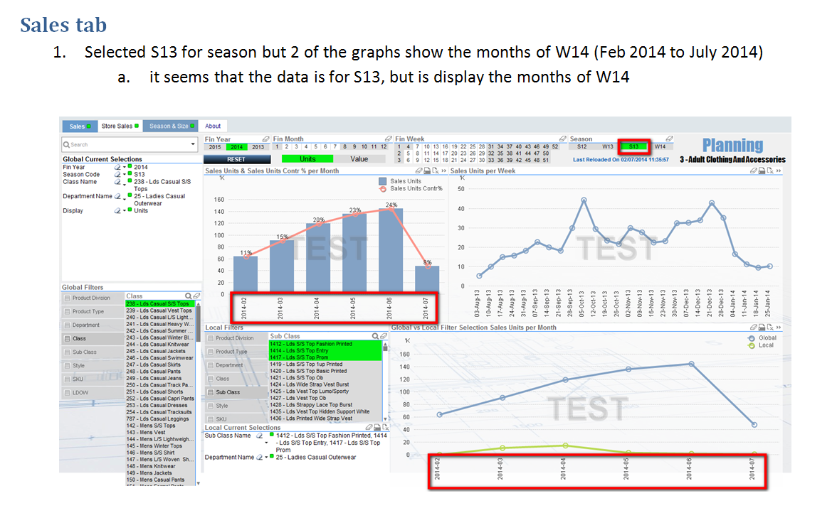
Example

Slide 8

Solution and Aim
To train Qlikview users in a simple, fun and easy to learn manner with the very tool they are facing issues with by implementing an in the middle application to teach them how to use their apps. If the app improves the usability the users will be able to be more productive and make more effective and efficient business decisions.

Slide 9

Research Questions
What is the current state and ideal state with usability of Qlikview apps and will the introduction of a “how to use” application reach that ideal state?
What are the main difficulties the users experience when using Qlikview apps?

Slide 10

Goals & Objectives
Meet with colleagues and discuss project
Measure the current state of Qlikview usability in our company
Develop the “How to use Qlikview” app according to data gathered from surveying
Implement “How to use Qlikview” app on our system and make available to the users.
Measure state of usability after implementation of the “How to use” app and see whether and compare results with the initial measurement to see if it is any closer to the ideal state of usability.

Slide 11

Discussion Time

